Slide 1
Non-cognitive development of first graders and their cognitive progress
Brun Irina, Ivanova Alina, Kardanova Elena, Orel Ekaterina
Center of Education Quality Monitoring, Institute of education
National Research University Higher School of Economics

Slide 2
Non-cognitive development and life outcomes: evidence from literature
Children who have good inter-personal skills and can self-regulate their behavior and emotions are more likely to associate well with their peers and their teachers, and to reap the benefits of their education (Merrell, Bailey, 2008)
Students, parents and teachers who navigate these social and emotional processes can have powerful influence on a multitude of important life outcomes (e.g., Kautz, et.al, 2014; OECD, 2015):
  mental health problems (Tackett, 2006; De Bolle, Beyers, De Clercq, and De Fruyt, 2012)
  Civic engagement and environmental awareness (Omoto, Snyder and Hackett, 2010; Milfont and Sibley, 2012)
  Crime / safety issues (Furnham and Taylor, 2004)

Slide 3
Research questions
Can we define meaningful patterns of cognitive, personal, social and emotional development in the early years of schooling?
Are these patterns related to the cognitive progress during the first year of school?
What contextual factors (family, demographic, etc.) are important for kids in each group?

Slide 4
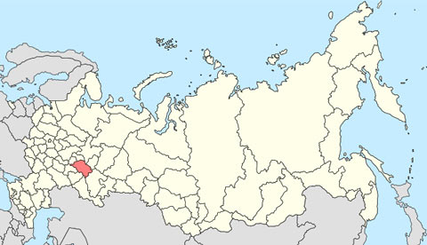
Methodology
Instrument: The International Performance Indicators in Primary Schools (iPIPS) – PSED questionnaire, math and reading scales: baseline and follow-up assessment.
Participants: Children enrolled in the 1st grade of school on the 1st of September 2014. Russian sample consists of 1202 children recruited from of 29 schools in one of the Russian regions located in the central part of Russia.
The capital | Kazan
Area | 67 847 km²
Population | 3 855 037 (2015)
Density | 56.82 pers./km²

Slide 5
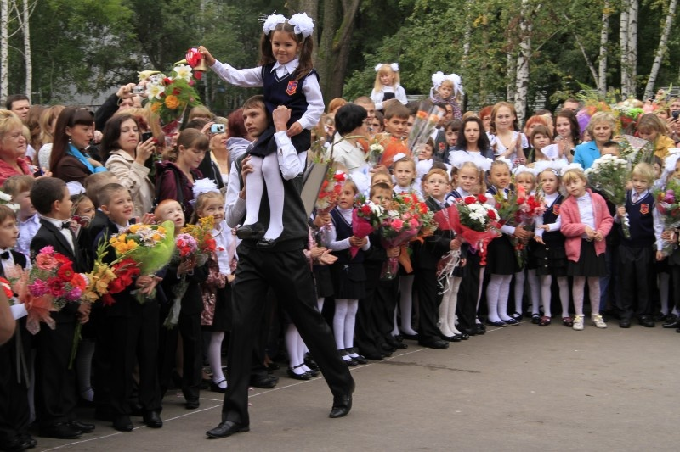
Russian system of primary education
7 year old children
1 teacher
4 years (grades 1-4)
No marks during the first year
No selection on the entrance

Slide 6
Personal, social and emotional development in iPIPS study
Adjusting to the school environment
Personal development
Social development
11 scales, 5 carefully described grades
Filled by teacher
Teacher assesses child’s behavior
Adjusted to Russian educational environment

Slide 7
Analyses
Principal component analysis for PSED scales;
IRT modeling for item analysis, dimensionality and reliability study, scale construction for cognitive and non-cognitive data, as well as for students’ estimation for all scales. Vertical equating is used to place the results from baseline and follow-up assessments on the common scale;
Hierarchical cluster analysis (k-means) – to define different groups of children based on their cognitive and non-cognitive development;
ANOVA – to estimate the differences in progress during the first year of schooling;
Regression analysis – to estimate the input of selected context variables.

Slide 8
Results 1: PSED dimensions
PSED dimensions | PSED factors (loadings)
Classroom behavior - refers to the skills which helps child to maintain concentration and ability to follow school rules and timetable. | Concentration 1: Teacher-directed activities (0.80)
 | Concentration 2: Self-directed activities (0.79)
 | Actions (0.85)
 | Rules (0.83)
 | Cultural awareness (0.56)
Communication - describes child’s social skills and ability to maintain relationships with peers and adults within the school and broader community. | Comfortable (0.73)
 | Independence (0.64)
 | Confidence (0.82)
 | Relationship to peers (0.56)
 | Relationship to adults (0.62)
 | Communication (0.52)

Slide 9


Results 2: IRT analysis
Rating Scale Model
Dimensionality study for 2 scales: PCA
Model fit analysis for each item
Quality of the response categories
Reliability study
Students’ measures
 | α | Rasch
Communication | 0.80 | 0.73
Classroom behavior | 0.86 | 0.82
 | mean | SD
Communication | 1.26 | 1.31
Classroom behavior | 0.67 | 1.93

Slide 10
Results 3: developmental patterns
 | Clusters
 | 1 (N = 214) | 2 (N = 403) | 3 (N = 270) | 4 (N = 164) | 5 (N = 151)
Math | 51.07 | 52.32 | 43.49 | 39.09 | 65.47
Reading | 53.06 | 54.22 | 42.82 | 37.66 | 62.79
Communications | 3.68 | 0.88 | 1.31 | -0.19 | 2.05
Classroom Behavior | 2.61 | -0.17 | 0.89 | -1.34 | 1.53
Cluster 1:
sociable and self-confident children
medium level of cognitive performance
Cluster 2:
not get used to the school environment, haven’t made friends and don’t feel comfortable at school
moderately good in class
Cluster 3:
quite sociable, but not properly adjusted to the school environment
medium low level of cognitive abilities
Cluster 4:
low level of all the characteristics assessed
Cluster 5
relatively high level of non-cognitive development
best cognitive results

Slide 11
iPIPS: cognitive scales and context
Cognitive measurements
(baseline and follow-up data)
Mathematics
Context (parents’ questionnaire)
Child: age (0.092), gender (0.28)
Family: mother’s education (0.15), age at birth (0.12), income (0.11), number of books (0.16)
Reading
Life: time to bed (0.0098), special training (0.17), nurcery the year before school (0.11)
Context variables were selected according to χ2 and Cramer’s V

Slide 12
Progress during the first year: descriptions for clusters
 | Cluster
 | 1 | 2 | 3 | 4 | 5
Math progress | 9.97 | 10.68 | 10.91 | 9.32 | 10.66
Reading progress | 8,67 | 7.14 | 11.6 | 11.19 | 10.9
Math follow-up | 61.55 | 62.95 | 53.98 | 48.29 | 75.53
Reading follow-up | 61.94 | 61.33 | 53.96 | 48.30 | 72.39
Follow-up results:
Math:
  Cluster 5 – best in Math
  Cluster 4 – lowest results
  Reading:
    Cluster 3, 4, 5 – significant differences
    No differences between clusters 1 & 2
Progress:
No significant differences in progress in math at all
Clusters 1 & 2 significantly differ in Reading

Slide 13
Relationships between cluster membership and background information
 | Cluster, % of cases
 | 1 | 2 | 3 | 4 | 5
Gender (male) | 27.4 | 57.0 | 38.1 | 67.7 | 60.0
Number of Books at home (more than 100) | 24.1 | 31.4 | 16.8 | 18.2 | 43.0
Mother’s education (higher) | 58.4 | 62.8 | 50.0 | 32.8 | 68.7
Income (more than 20,000 rub per month) | 83.8 | 85.3 | 77.2 | 69.5 | 81.1
Nursery the year before school (yes) | 91.3 | 87.4 | 86.6 | 79.3 | 92.0
Special training before school (yes) | 24.1 | 31.4 | 16.8 | 18.2 | 43.0
Socio-demographical
Economical
Pre-school related

Slide 14
Significant predictors for Follow-up Scores
Cluster | Cognitive domain | Predictors | R²
1 | Math | Income | 0.44
 | Reading | Gender | 0.28
2 | Math | Gender, Mother’s Education | 0.39
 | Reading | Mother’s Education | 0.27
3 | Math | Mother’s Education | 0.33
 | Reading | Gender, Income | 0.17
4 | Math | - | 0.4
 | Reading | - | 0.24
5 | Math | Number of books, Mother’s Education | 0.58
 | Reading | Income, Mother’s Education | 0.56
Baseline scores significantly predict success for all groups
Variance explained by predictors is lower for Reading
No significant predictors found for students from 4th cluster
The model predicts best follow-up scores for the 5th cluster
Linear regression,, Sig.0.05

Slide 15
What is going on with clusters 4 and 5?
4th Cluster
Math F = 18.71 + 0.76*Math B + e
Reading F = 24.33 + 0.65*Reading B + e
5th Cluster
Math F = 2.94*Books + 1.02*Education M + 1.14*Math B + e
Reading F = -2.63*Income + 1.95*Education M + 1.19*Reading B + e
Math F – follow-up Math score
Math B – base-line assessment score

Slide 16
Conclusion
2 scales were developed based on PSED: classroom behavior and communication.
5 groups of children were distinguished based on their baseline assessment and non-cognitive scales:
These groups differ by their follow-up scores: 3rd , 4th and 5th Cluster differ amongst themselves and from 1st and 2nd cluster in reading.
No connection was found between non-cognitive development, contextual information and children’s progress during first year of school.
 | Cluster
 | 1 | 2 | 3 | 4 | 5
Cognitive development | medium | medium | low | low | high
PSED | high | medium | medium | low | high

Slide 17

Thank you! eorel@hse.ru ibrun@hse.ru

Slide 18
Discussion
Why there is no connection between cognitive progress during first year and non-cognitive development?
Why there are no significant predictors for children from 4th cluster?
Limitations:
Sample size

Slide 19
1st Cluster
Math F = 9.95 + 2.42*Income + 0.90*Math B + e
Reading F= 21.45 + 3.35*Sex + 0.71*Reading B+ e
2nd Cluster
Math F=19.76 – 1.63*Sex + 0.76*Education M + 0.78*Math B + e
Reading F= 14.27 + 0.94*Education M + 0.79*Reading B + e
3rd Cluster
Math F=21.67 +0.97* Education M + 0.65* Math B + e
Reading F= 32.6 + 2.38*Income + 3.4*Sex +0.35*Reading B+ e

